Slide 1

Project Presentation “Customer Retention”
Presented by:
Vikas Kumar Mishra

Slide 2
Agenda
Overview.
What is customer Retention?
Need for customer retention.
Problem Statement.
Problem Understanding.
Exploratory data analysis.
Visualization.
Conclusion.

Slide 3
1. Overview
In this particular presentation we will be looking on:
How to analyze the dataset of Customer Retention
What is the criterion to achieve Customer Retention
Overall analysis of the problem.

Slide 4
2. What is Customer Retention?
Customer retention is a metric that measures customer loyalty, or the ability of an organization to keep its customers over time. In addition to identifying the number of loyal customers, customer retention can reflect or predict customer satisfaction, repurchase behavior, customer engagement, and emotional ties to a brand.

Slide 5
3. Need of Customer Retention
Less spending on customer acquisition: Acquiring a new customer can be up to five times more expensive than retaining an existing one.
Increased profits: An increase in client retention by 5% can enhance profits by over 25%.
Improved online reputation: Over 37% of customers will only post online reviews if they are “extremely satisfied”.
Positive Reviews: The longer customers stay with a company, the more business, and positive reviews, and they bring word-of-mouth advertising

Slide 6
4. Problem Statement
Customer satisfaction has emerged as one of the most important factors that guarantee online store success; it has been posited as a key stimulant of purchase, repurchase intentions, and customer loyalty. A comprehensive review of the literature, theories, and models has been carried out to propose the models for customer activation and customer retention. Five major factors that contributed to an e-commerce store’s success have been identified: service quality, system quality, information quality, trust, and net benefit. The research furthermore investigated the factors that influence online customers to repeat purchase intention. The combination of both utilitarian value and hedonistic values is needed to affect the repeat purchase intention (loyalty) positively.

Slide 7
5. Problem Understanding
Customer retention means the process of maintaining or keeping customers once you have acquired them. It’s all the activities that a company must do in order to keep their customers around. The goal is to build a long-lasting relationship between the brand and consumers. Once a customer becomes loyal to your brand, not only he will buy more from you than a normal customer but he’ll spread good words about your business, and increase your reputation. Thus in this particular problem solution, I have used all my analysis skills to solve the problem of customer retention.

Slide 8
6. Exploratory data analysis
I have imported the dataset which was in excel format. Then I did all the statistical analysis like checking shape, unique value counts, info etc…..
I have checked for null values but there were no null values in the dataset.

Slide 9
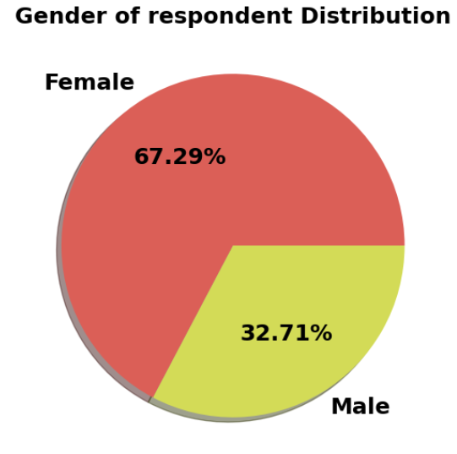
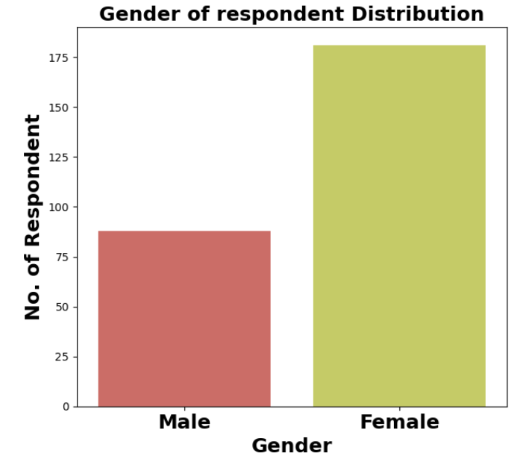
7. Visualization

Slide 10
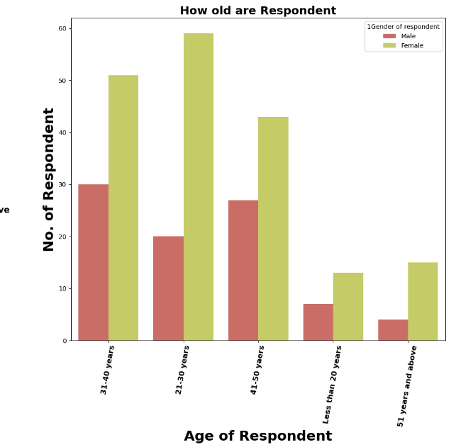
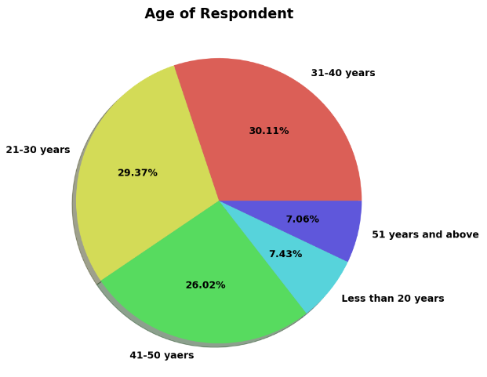
7. Visualization

Slide 11
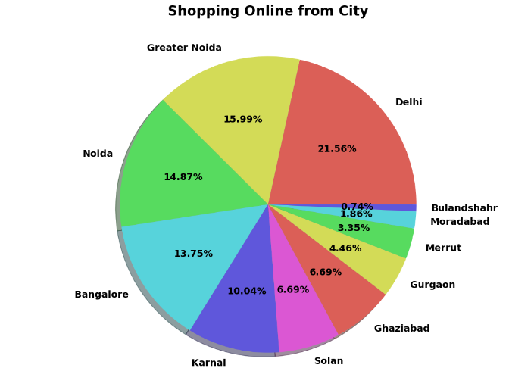
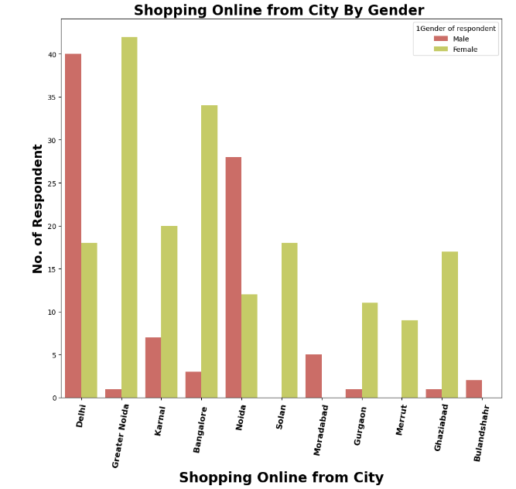
7. Visualization

Slide 12
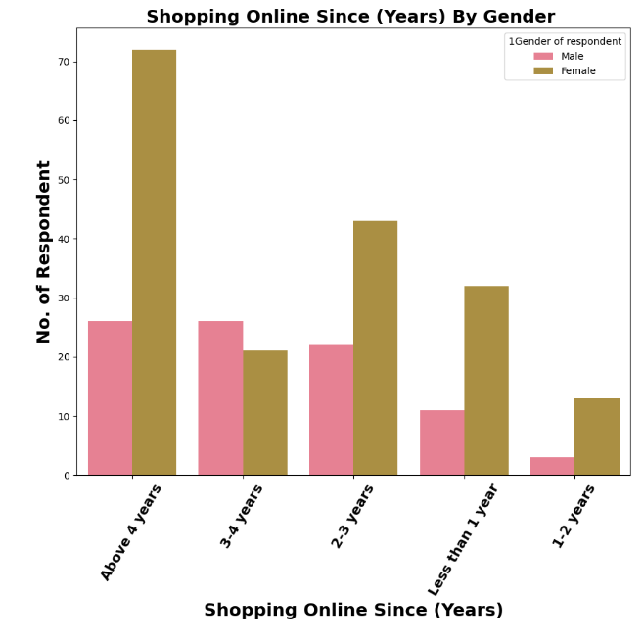
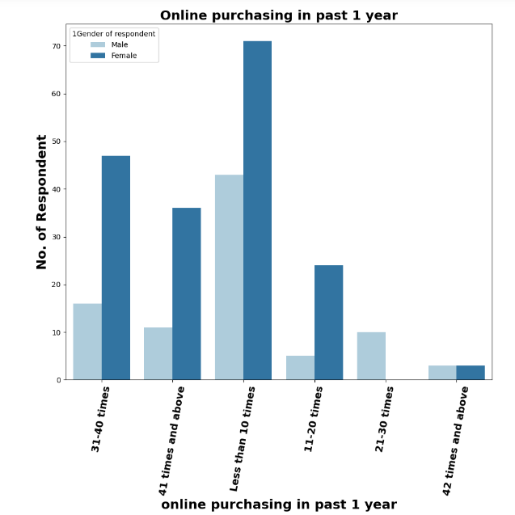
7. Visualization

Slide 13
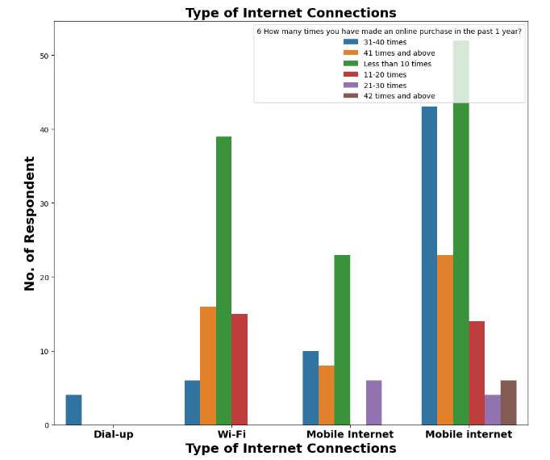
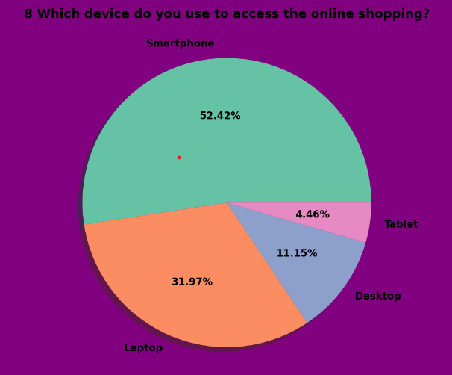
7. Visualization

Slide 14
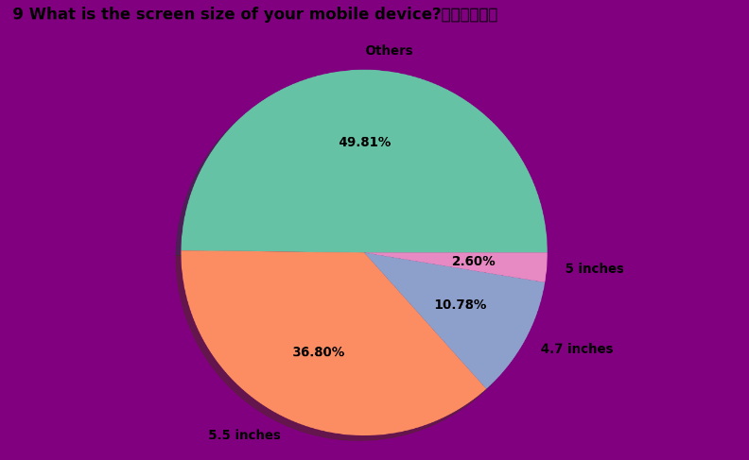
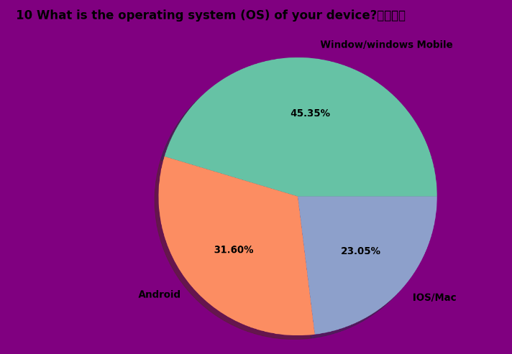
7. Visualization

Slide 15
7. Visualization
Females are doing more shopping compared to men and females in the age group 21-30 and men in the age group 31-40 are shopping more than other age groups.
I found more customers in Great Noida and they belong to above 4 years of online shopping experience.
In all the frequencies of online purchases in the past 1 year the usage of mobile internet for internet access is having a high count.
All smartphone users have a maximum count for 5.5 inches screen size and for all other devices screen size is not specified i.e., others option.

Slide 16
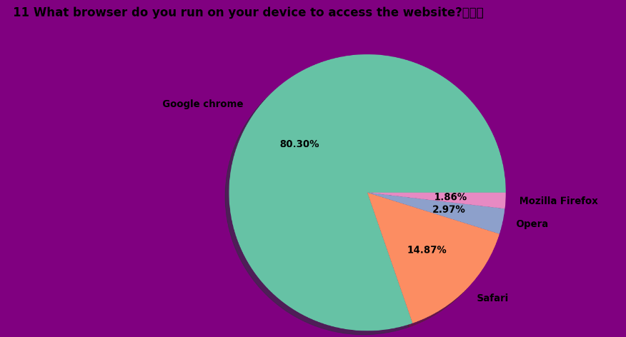
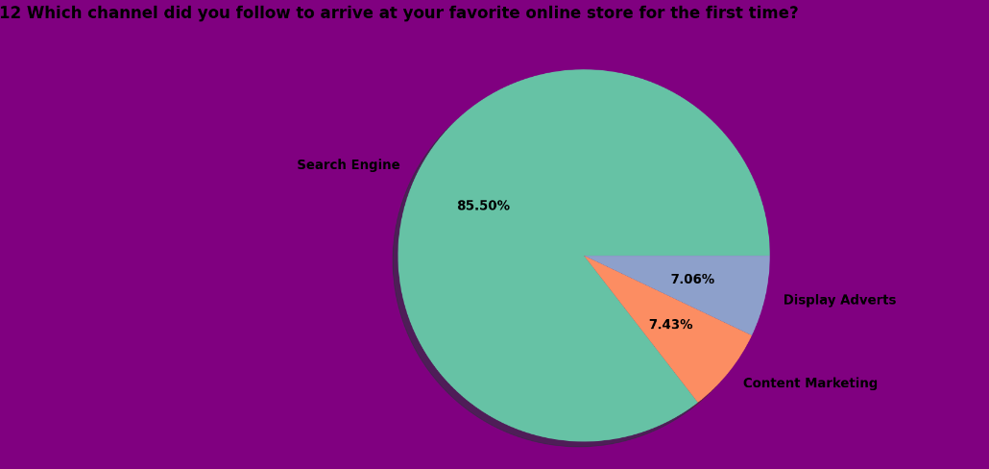
7. Visualization

Slide 17
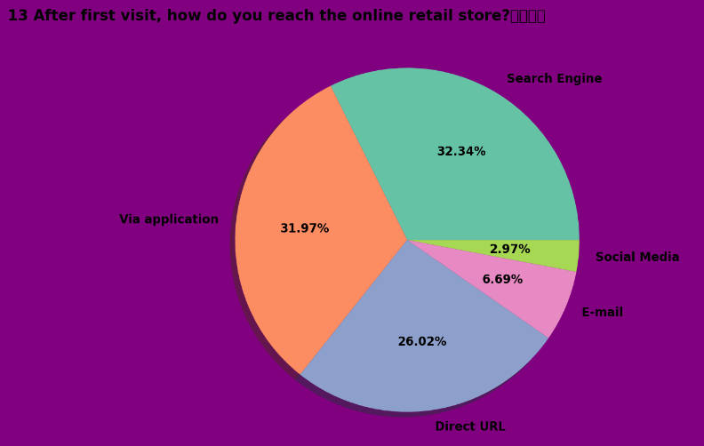
7. Visualization

Slide 18
7. Visualization
All the window users and max Android users use Google Chrome as their browser and IOS/Mac users use Safari as their browser.
Maximum customers use Search Engine to visit the online store for the first time and after the first visit also again log in using search engines so search engines are a good mode to get a hike in the number of customers.
Maximum customers use the e-retail shop for more than 15 mins to make the purchase decision and max customers use credit/debit cards as a payment option.
Maximum customers sometimes abandon and the maximum reason for abandoning is to get a better alternative offer.

Slide 19
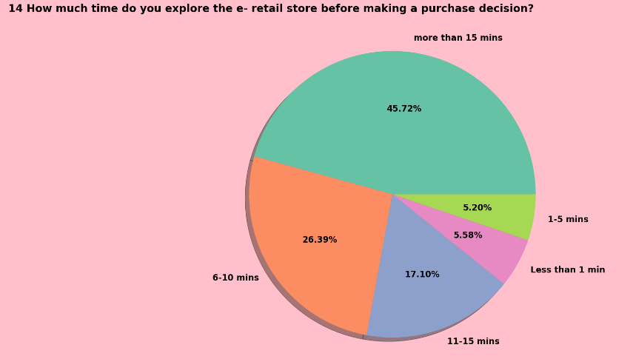
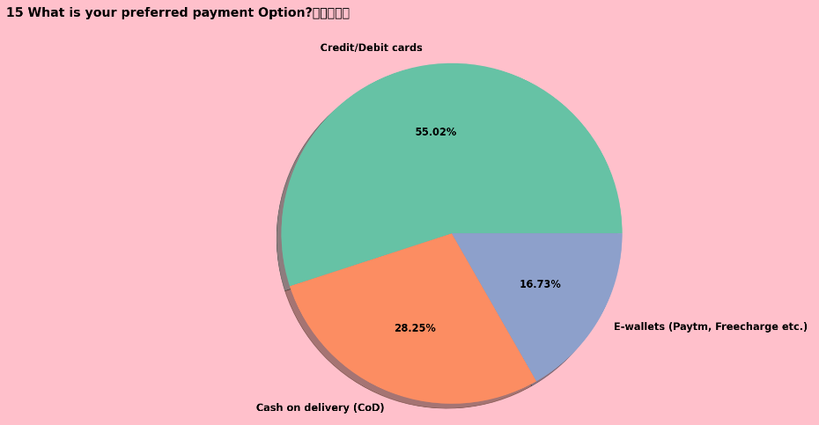
7. Visualization

Slide 20
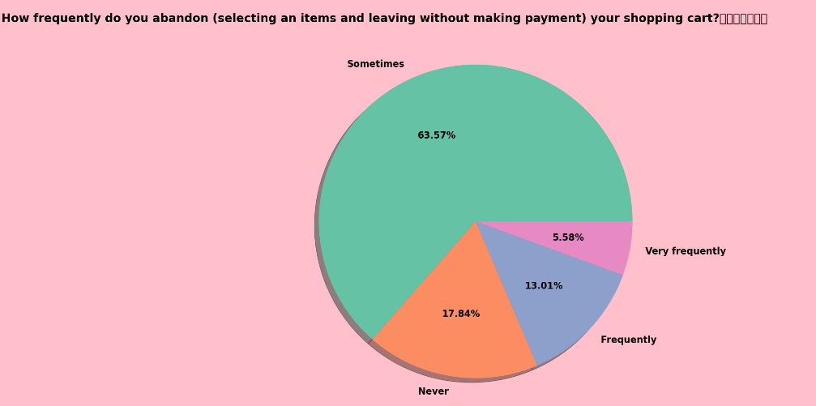
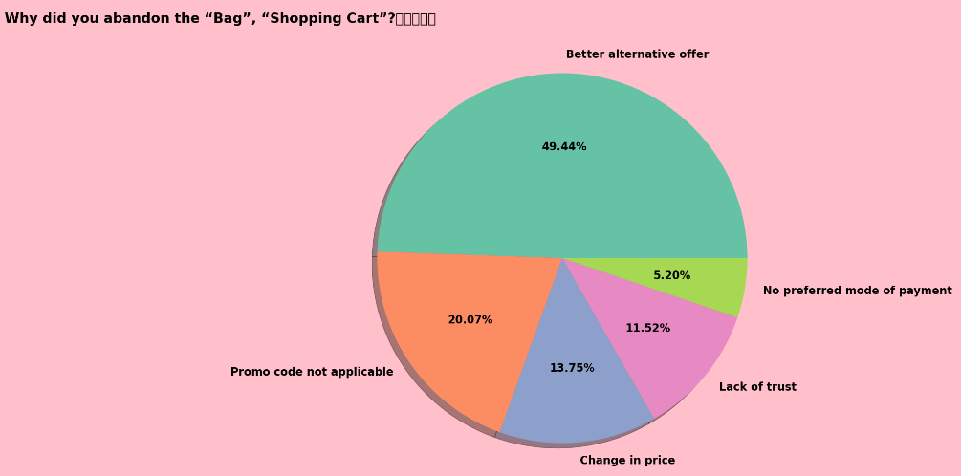
7. Visualization

Slide 21
7. Visualization
Maximum customers agree to have the content on the web page be easy to read and understand and also they agree to get information on a similar product to the one highlighted is important for product comparison.
Maximum people agree to have all relevant information on listed products and agree with complete information on the listed seller and product being offered is important for the purchase decision.
Maximum customers agree to get easy navigation on the website and they want to have loading and processing speed.
Maximum customers want a user-friendly interface of the website and convenient payment methods.

Slide 22
7. Visualization
Maximum customers agree to get Trust that the online retail store will fulfill its part of the transaction at the stipulated time and expects Empathy towards the customers.
Maximum customers want to have guaranteed privacy of the customer and they wish to have Responsiveness and availability of several communication channels.
Maximum customers agree that Online shopping gives monetary benefits and discounts and they also agree that Enjoyment is derived from shopping online.
Maximum customers agree that shopping online is convenient and flexible and they also agree that the return and replacement policy of the e-tailer is important for the purchase decision.

Slide 23
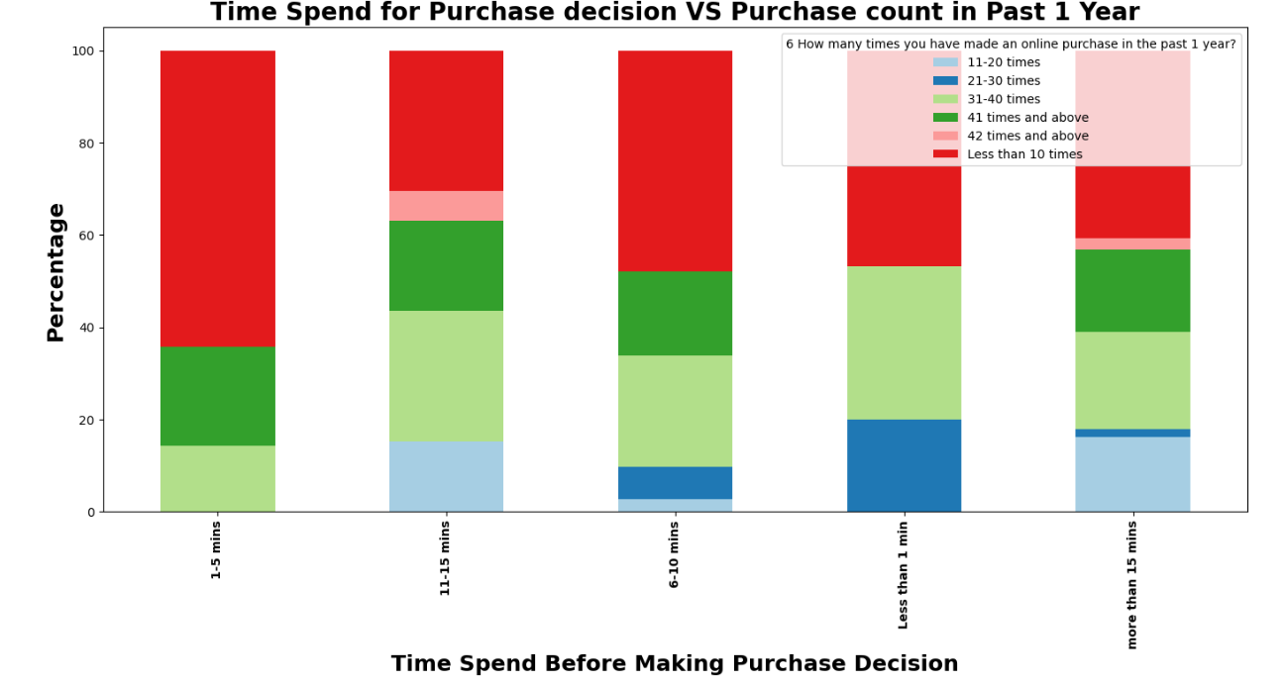
7. Visualization

Slide 24
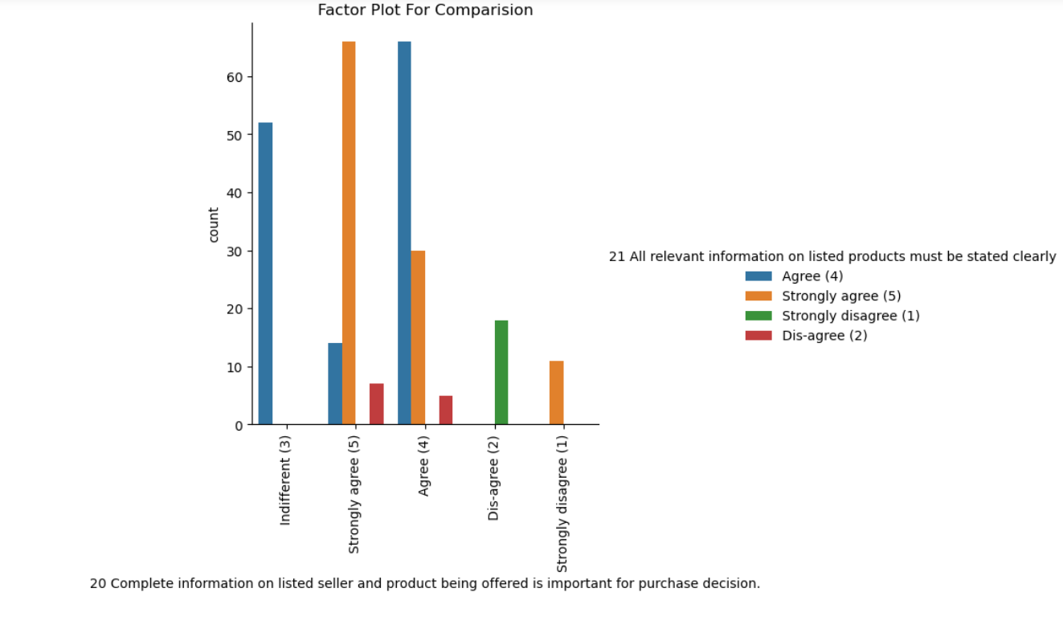
7. Visualization

Slide 25
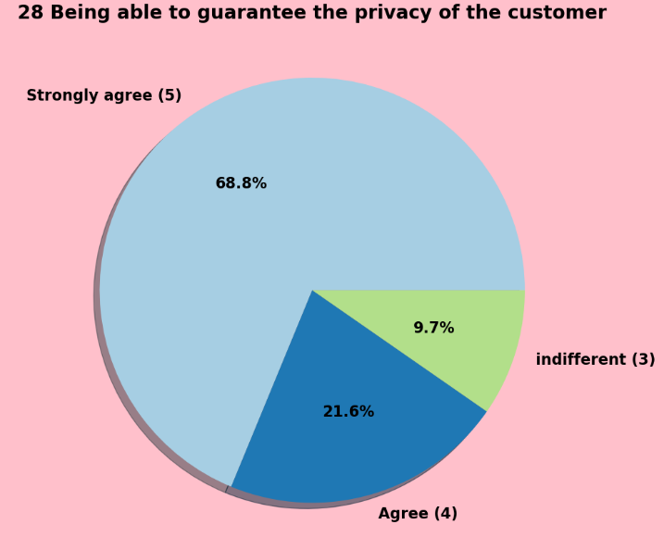
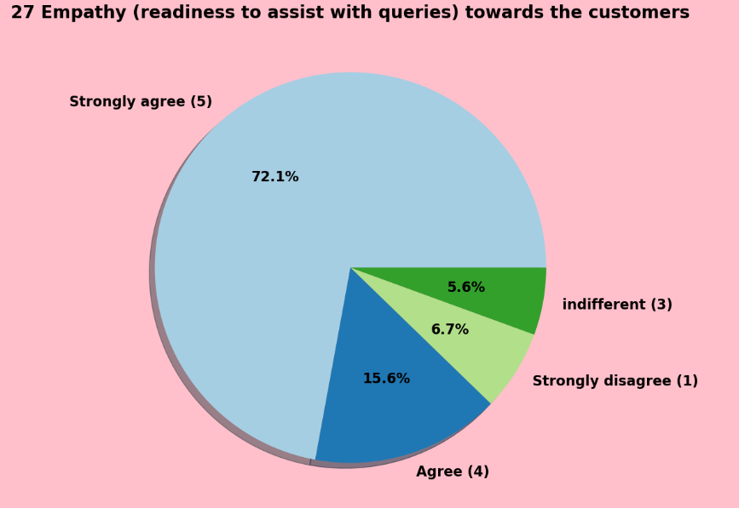
7. Visualization

Slide 26
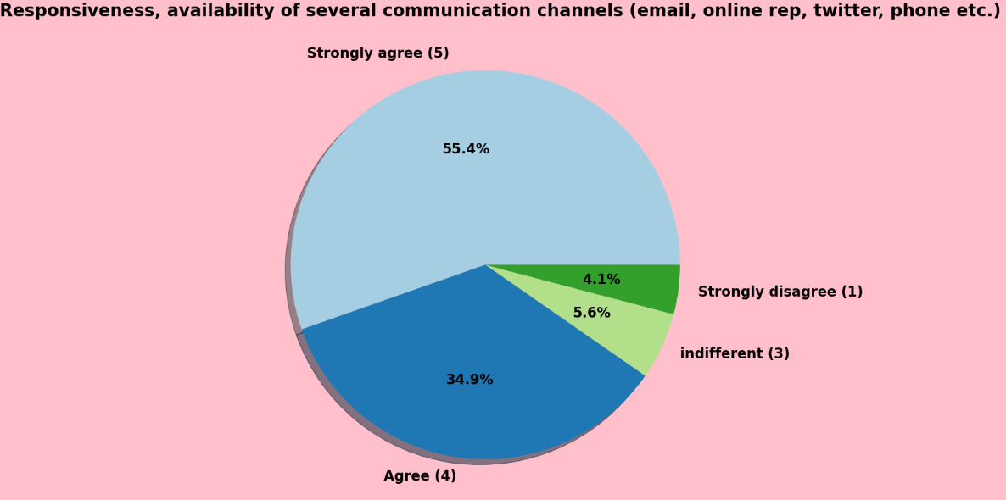
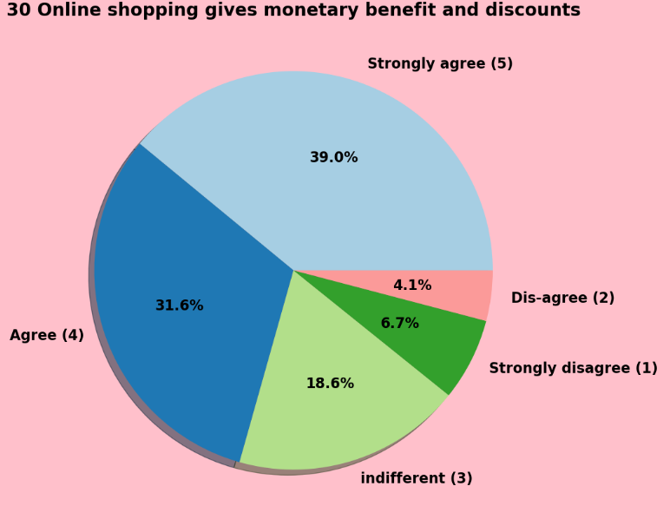
7. Visualization

Slide 27
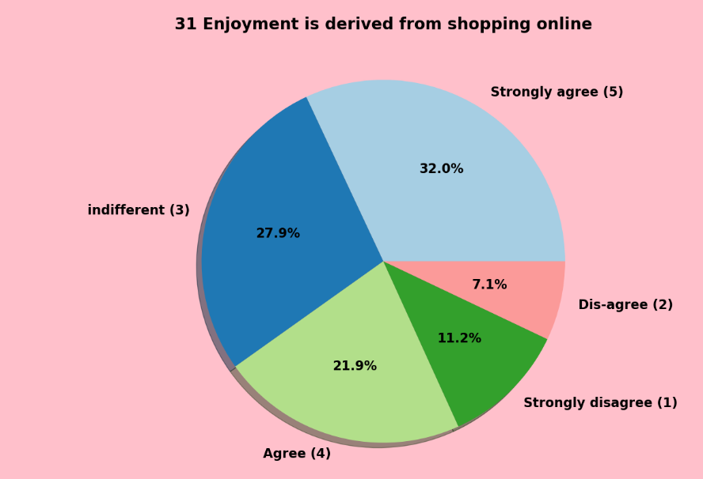
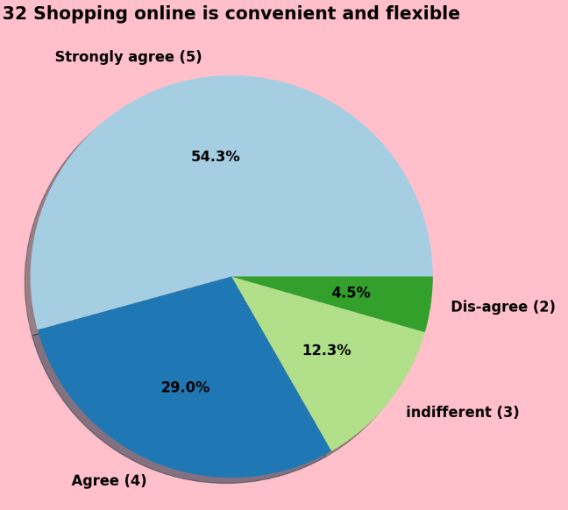
7. Visualization

Slide 28
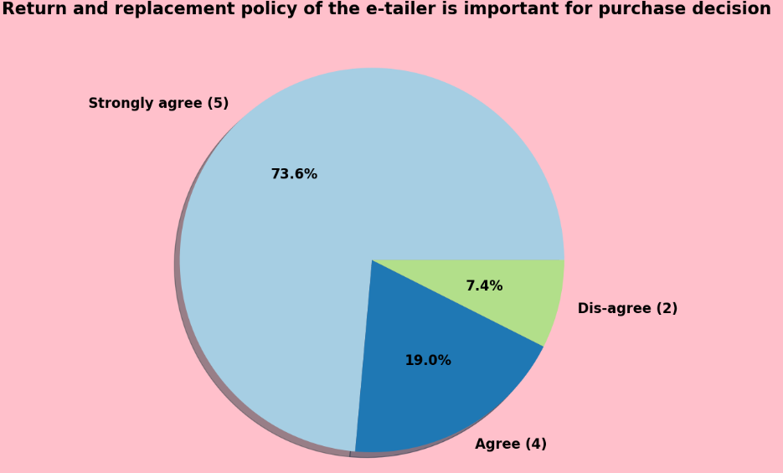
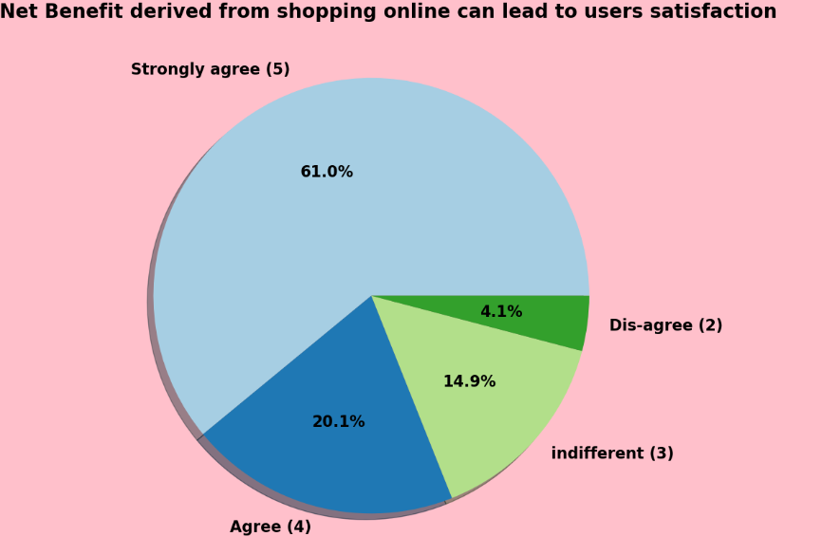
7. Visualization

Slide 29
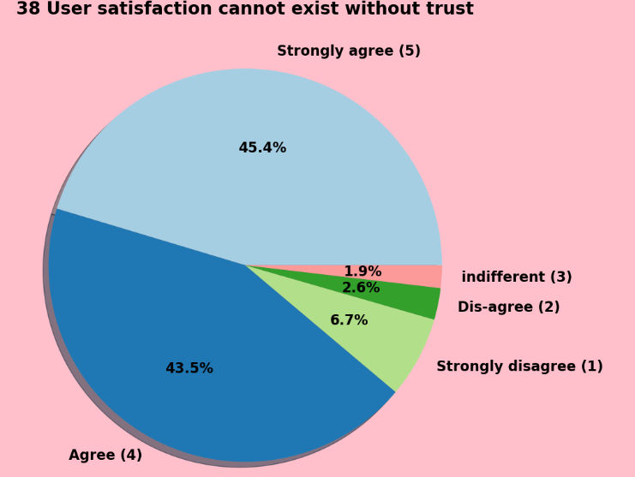
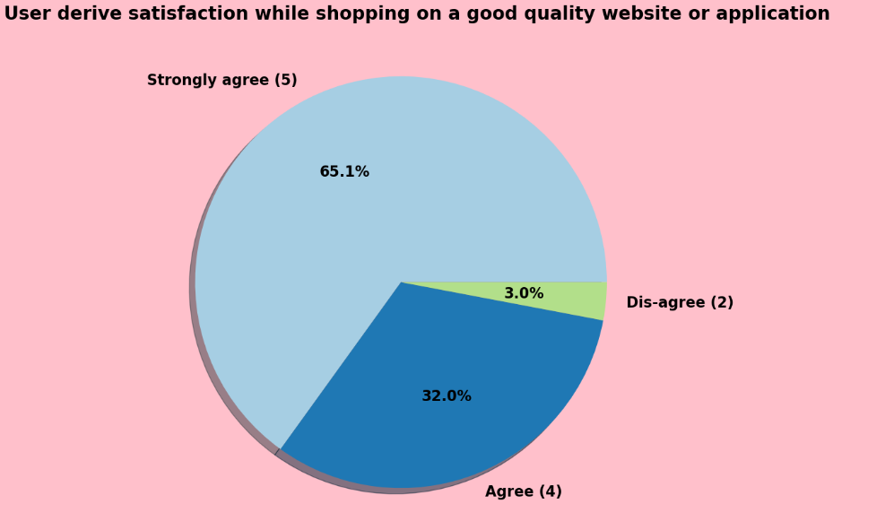
7. Visualization

Slide 30
7. Visualization
Max customers agree with Gaining access to loyalty programs is a benefit of shopping online and they also agree that displaying quality information on the website improves satisfaction of customers.
Maximum customers agree that user derives satisfaction while shopping on a good quality website or application and they also agree that net benefit derived from shopping online can lead to users satisfaction.
Max customers agree to have user satisfaction cannot exist without trust and they also agree that offering a wide variety of listed products in several categories.
Max customers agree to have the provision of complete and relevant product information and they also agree to have monetary savings.

Slide 31
7. Visualization
Max customers agree for having the convenience of patronizing the online retailer and they also agree that shopping on the website gives us a sense of adventure.
Max customers agree that they feel gratification shopping on their favorite retailer and they also agree that shopping on your preferred e-tailer enhances their social status.
Max customers agree shopping on websites helps to fulfill certain roles and they also agree that getting value for money spent.

Slide 32
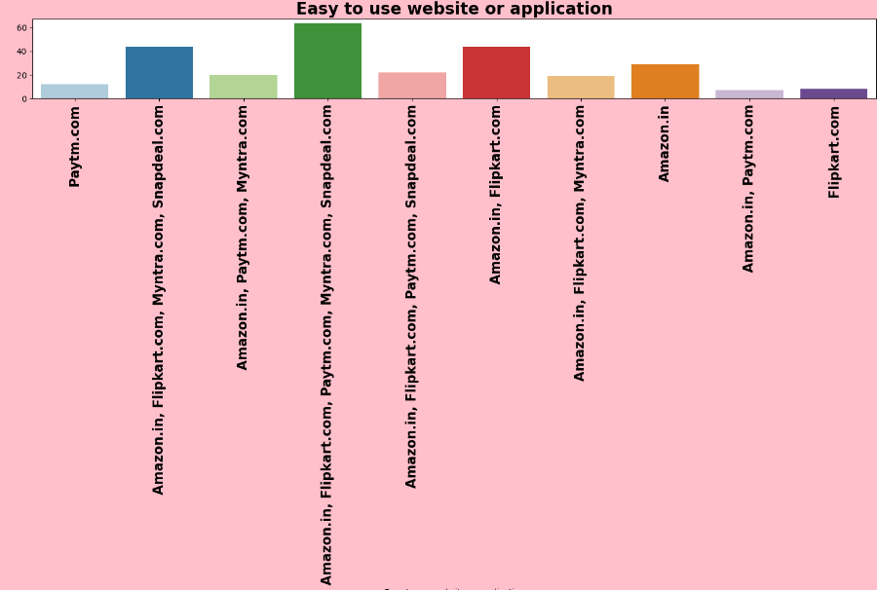
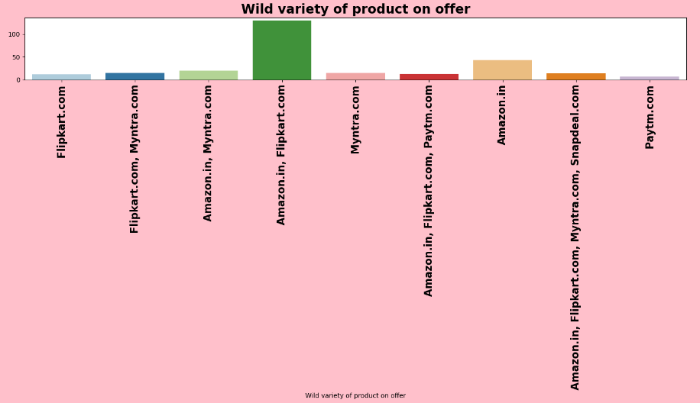
7. Visualization

Slide 33
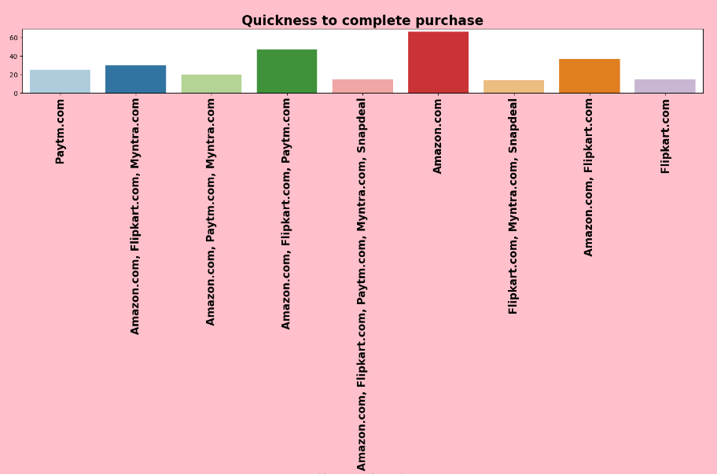
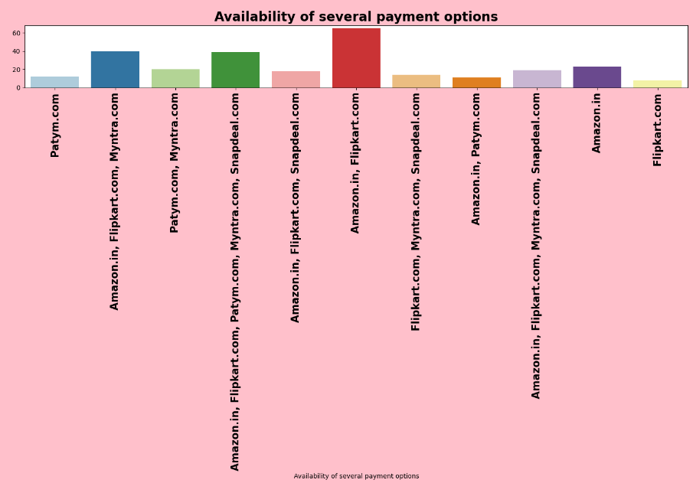
7. Visualization

Slide 34
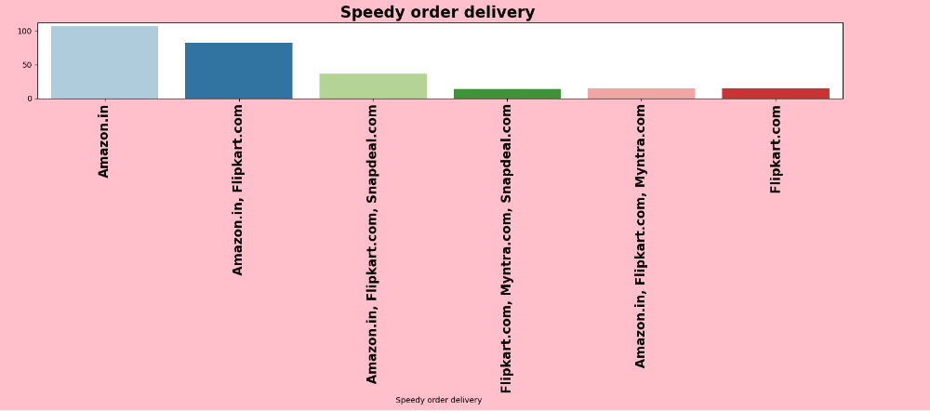
7. Visualization

Slide 35
7. Visualization
Max customers chose that all the available online shopping platforms are easy to use and they also shop from all the online shopping websites.
Maximum customers chose Amazon and Flipkart as the best visually appealing web-page layout and best platform which gives a wide variety of products on offer.
Most of the customers chooses Amazon and Flipkart as the best platform that gives complete relevant description information of products and also they chose Snapdeal as the fast-loading website.
Max customers say that the Reliability of the website or application and quickness to complete the purchase is good with Amazon.

Slide 36
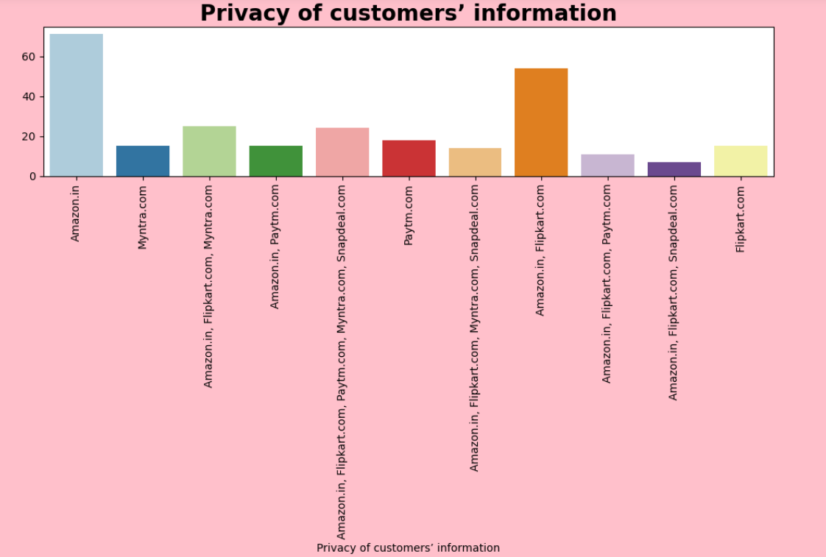
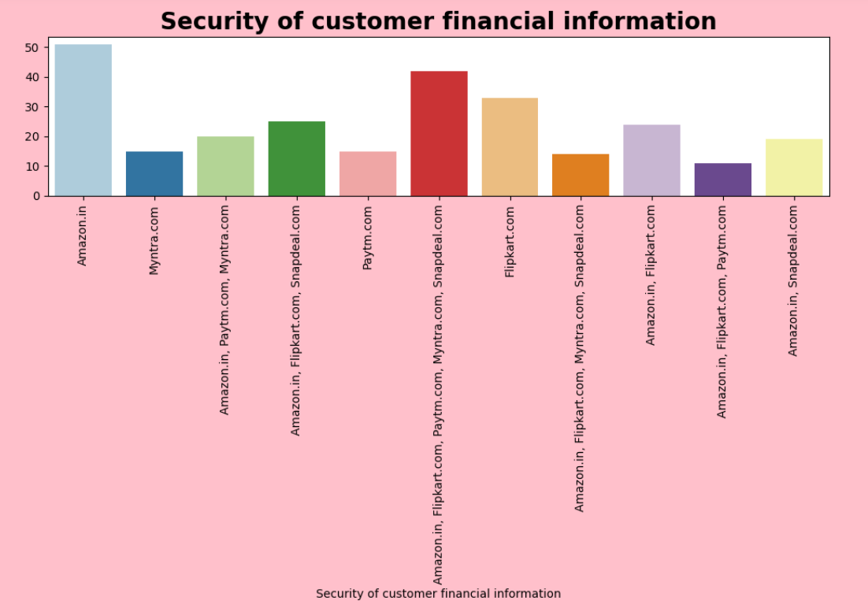
7. Visualization

Slide 37
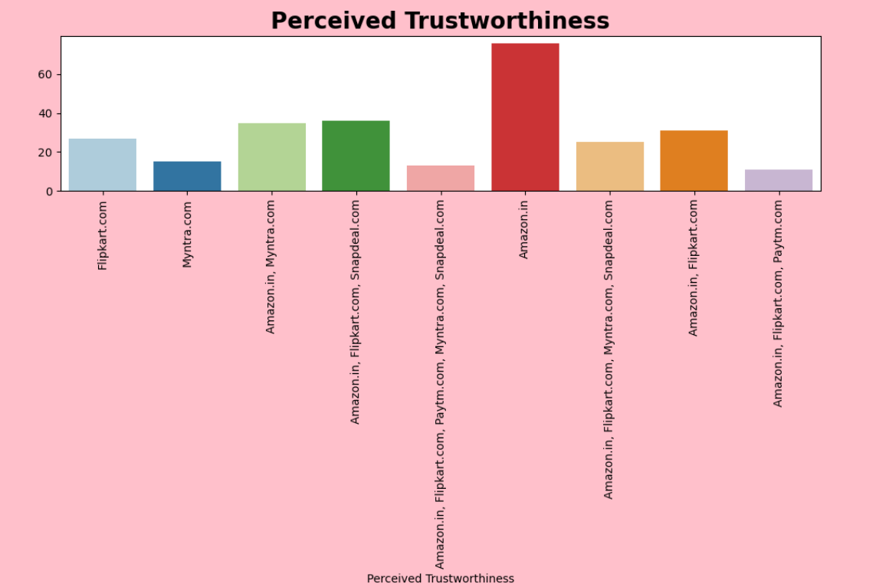
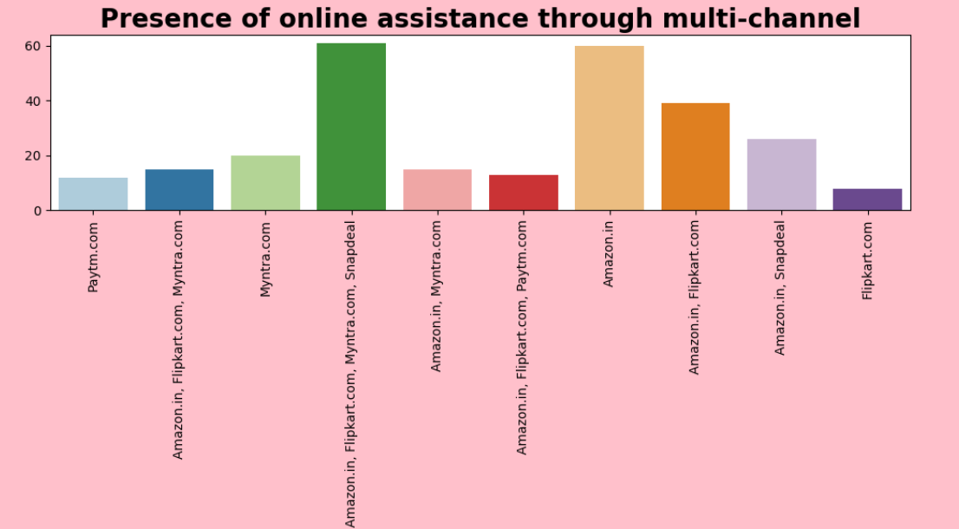
7. Visualization

Slide 38
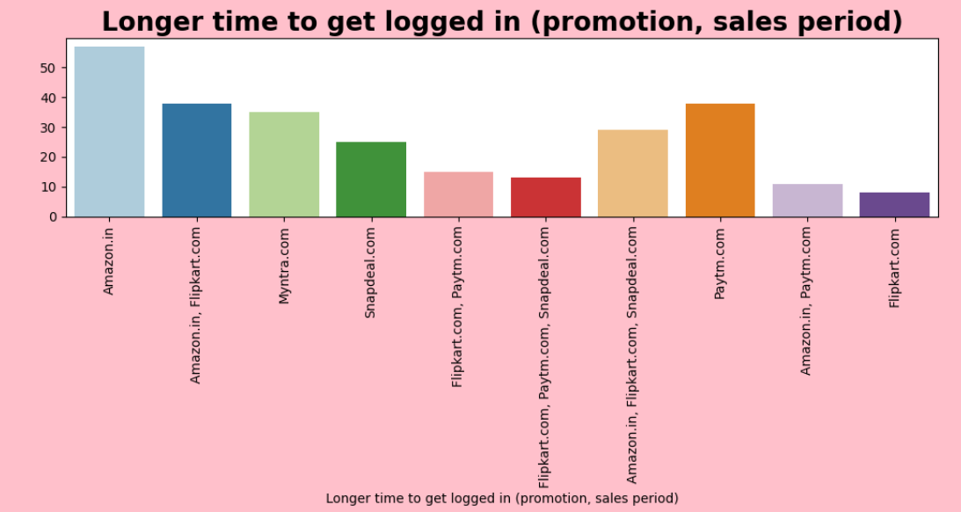
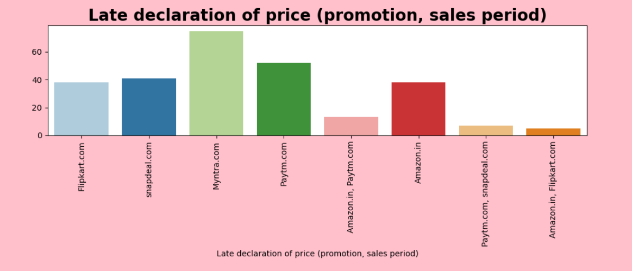
7. Visualization

Slide 39
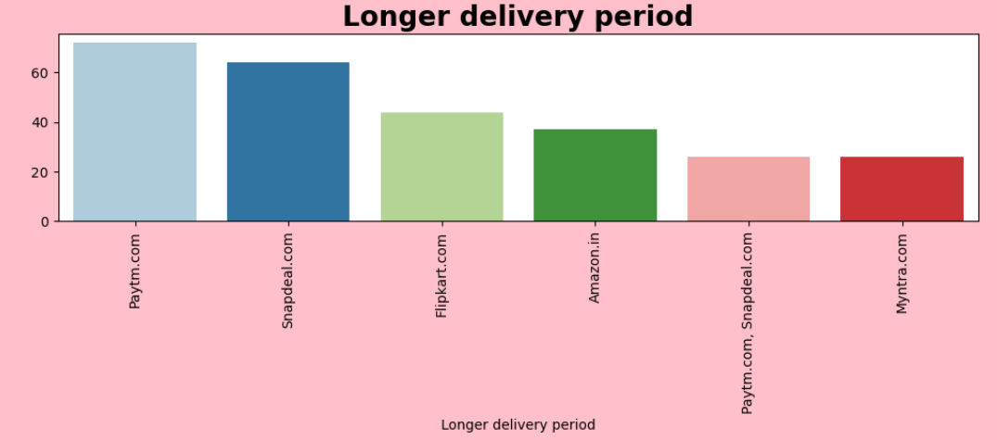
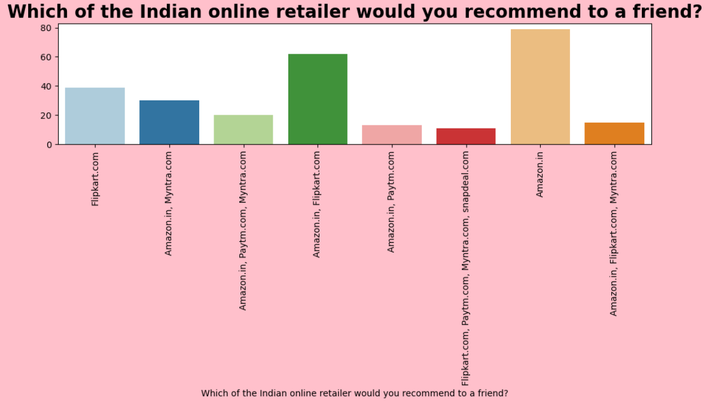
7. Visualization

Slide 40
7. Visualization
Max customers choose Amazon and Flipkart as having the best payment option available and also they are giving the fastest delivery also.
Max customers choose Amazon for giving the best customers information privacy and also for giving the best financial information security.
Amazon is the best online shopping mart which gives perceived trustworthiness and it has the presence of online assistance through multi-channel.
Since Amazon is the busiest online shopping platform it is also having drawbacks of taking a long time to log in and taking longer time in displaying graphics and photos.

Slide 41
7. Visualization
Max customers say that the drawback of having a late declaration of price is with Myntra and the longer page loading time is with Flipkart.
Snapdeal has the drawback of having limited payment modes and also it has a complaint about late delivery.
Max customers say that Amazon is the platform with good website/application design and also amazon has a drawback of disruption of pages when moving from one page to another.
Max customers say that the efficiency of the website is good with Amazon and also amazon is recommended by most of the customers.

Slide 42
8. Analysis
Most of the customers are females with age 20-50 and they used mobile internet to access Windows as the operating system.
And most of the customers used search engines to get into the platform for the first time and frequently.
Max customers use their debit/credit cards for their payment.
Compared to other platforms shopping with Amazon and Flipkart has maximum benefits rather than drawbacks.
Compared to all other online shopping platforms Snapdeal and Myntra has maximum drawbacks.
And having maximum good feedback Amazon is recommended by most of the customers.

Slide 43
9. Conclusion
Females are furious to shop all the time so making them satisfied will help the sellers to get more business.
Loyal customers prefer buying and tend to spend more money on shopping in your store. Statistics show that engaged consumers purchase more frequently. It is necessary to hear customer feedback because most of them are valuable feedback.
Sometimes customer feedback is the best marketing strategy. They are frequent customers so they will know which areas of your business may well be improved. If their feedback is approved, they will be extremely excited and support your company to the best ability.
Organisation will always focus on success for that keeping the old customers will always be a plus point.
Amazon and Flipkart are standing best out in the market by using ethical, reasonable business strategies.

Slide 44
THANK YOU
SUBMITTED BY: VIKAS KUMAR MISHRA
BATCH: INTERNSHIP 32,
ID: 44

